Slide 1
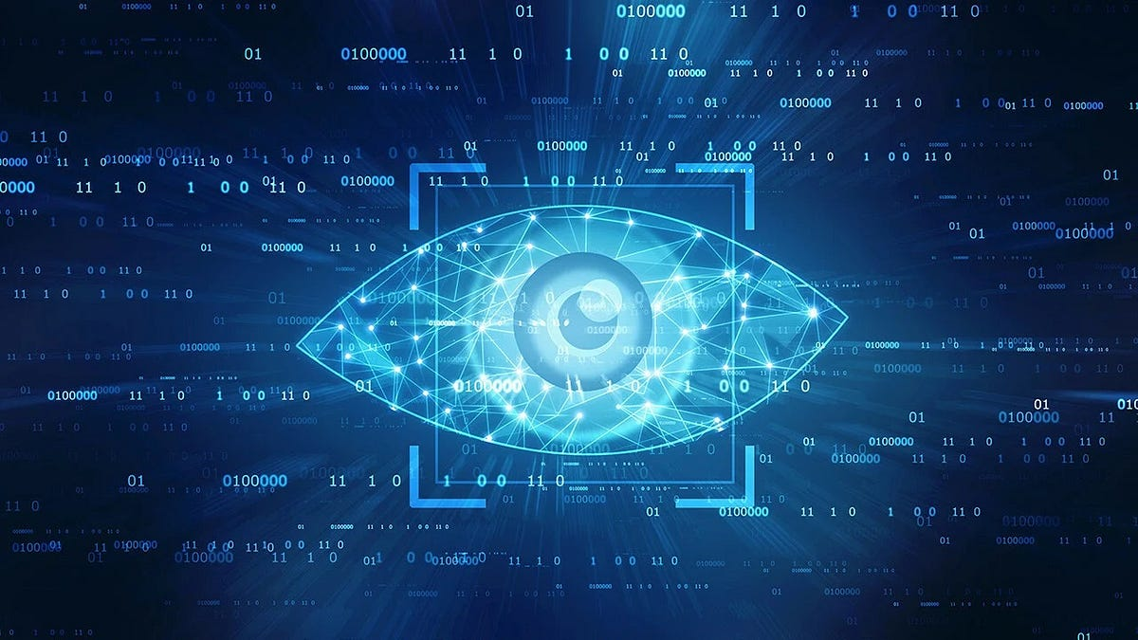





SESSION 1.2
OPEN CV
Day 1 - session 1.2
TOOL FOR IMAGE PROCESSING
By:
Ansik Singh Tomar (Aanshik)
Coordinator:
Technocrats
Venue:
LG1
Time:
09:00 P.m.

Slide 2








SESSION OVERVIEW
What is OpenCV
How Images Work
Introduction to computer vision library
Understanding pixels and matrices
Reading & Displaying Images
Image Properties
Loading and showing images
Accessing shape, height, width
Drawing Shapes
Capturing Video
Lines, rectangles, circles, text
Real-time webcam processing
Frame Processing
Building Cool Project
Processing pipeline concepts
Hand tracking robotic control
SESSION 1.2

Slide 3
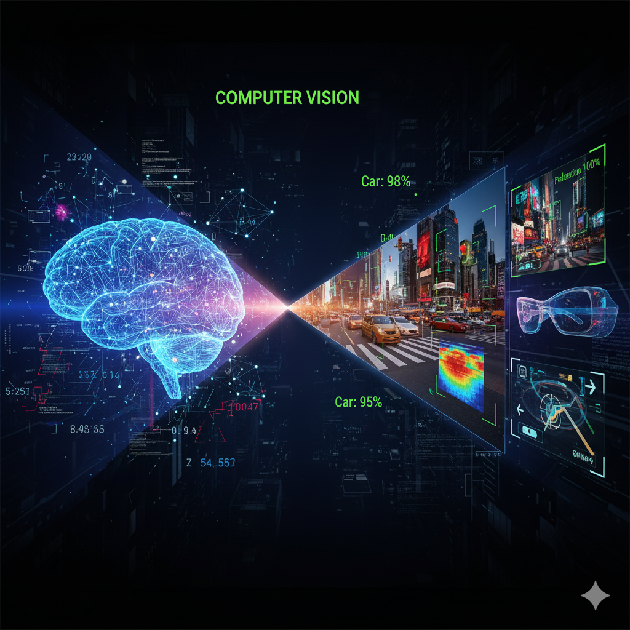






WHAT IS OPENCV?
OpenCV (Open Source Computer Vision Library)
A powerful library that enables computers to see and understand images or videos through advanced algorithms.
Image Processing
Video Processing
Manipulate and analyze images
Real-time video analysis
Object Detection
Face Recognition
Identify objects in scenes
Detect and identify faces
Gesture Detection
Robotics Vision
Recognize hand gestures
Enable robot perception
SESSION 1.2

Slide 4
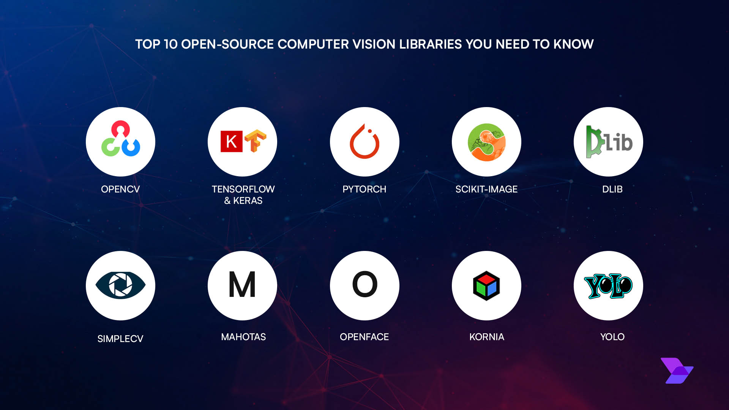




OPENCV APPLICATIONS
Projects use OpenCV to build powerful vision applications:
Capture Video
Stream frames from webcam in real-time
Process Frames
Apply filters, transformations, and algorithms
Draw Landmarks
Mark features like faces, hands, and objects
Display Results
Show processed output on screen
SESSION 1.2

Slide 5


INSTALLING OPENCV
Installation Command
OpenCV is easily installed using Python's package manager pip. Run this command in your terminal:
1
Open Terminal
Launch command prompt or terminal
Terminal
2
Run Command
Execute pip install opencv-python
3
Wait for Download
Package downloads and installs
Requirements
Python 3.6+ recommended pip package manager installed Internet connection for download
4
Verify Installation
Import cv2 and check version
SESSION 1.2

Slide 6





TESTING INSTALLATION
Verification Code
Run this simple Python code to verify OpenCV is installed correctly:
Output
test_opencv.py
Installation Successful
Version number displayed without errors
This imports the OpenCV library and displays its version number, confirming successful installation.
Installation Failed
ModuleNotFoundError means installation needed
SESSION 1.2

Slide 7
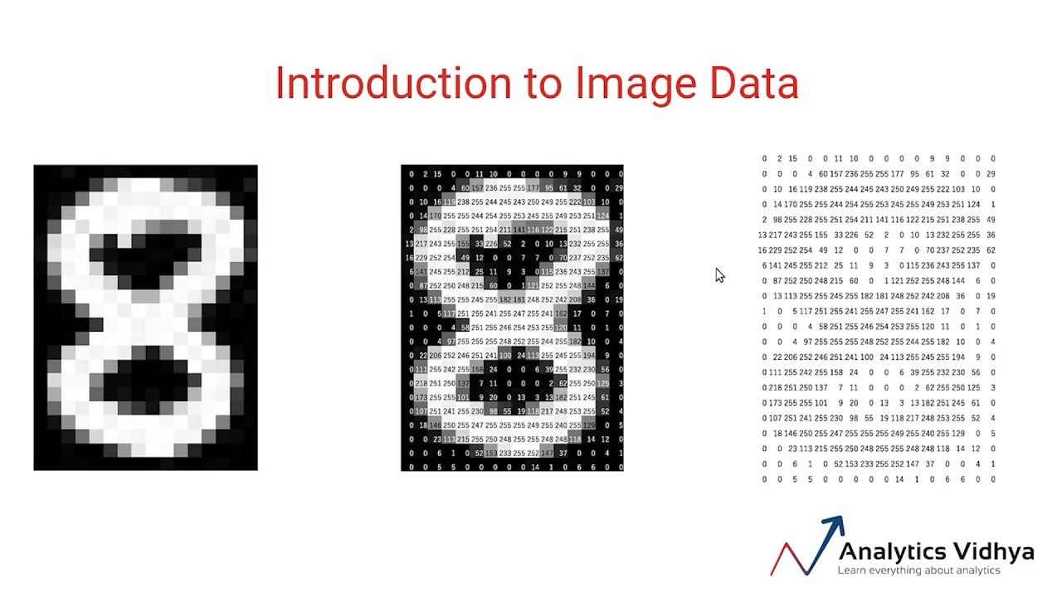


HOW IMAGES WORK IN OPENCV
An image is just a matrix of pixels. Each pixel contains color information stored as numerical values.
Example Image
720 x 1080 pixels
Height: 720 rows | Width: 1080 columns
Pixel Structure
[B, G, R]
3 values per pixel
Each value ranges from 0-255 representing color intensity
Pixel Grid Representation
SESSION 1.2

Slide 8


UNDERSTANDING PIXELS
Each pixel contains 3 values representing BGR color intensities
Important Note
[255, 0, 0]
OpenCV uses BGR color format by default, not RGB!
Blue - Maximum blue intensity
Standard Format
OpenCV Format
RGB
BGR
[0, 255, 0]
Green - Maximum green intensity
Red, Green, Blue
Blue, Green, Red
This is crucial when working with different libraries or displaying images. Many ML models require RGB format.
[0, 0, 255]
Red - Maximum red intensity
SESSION 1.2

Slide 9




BGR vs RGB FORMAT
Different libraries use different color formats. Understanding this is crucial for proper image processing.
Conversion Required
When using MediaPipe with OpenCV, you must convert from BGR to RGB format.
OpenCV
B
G
R
Conversion Code
Blue → Green → Red
MediaPipe
This ensures proper color interpretation when passing frames between libraries. Failure to convert can cause incorrect colors in output.
R
G
B
Red → Green → Blue
SESSION 1.2

Slide 10




READING & DISPLAYING IMAGES
cv2.imread()
cv2.imshow()
Load Image
Display Image
Reads an image from the specified file path and loads it into memory as a NumPy array.
Displays an image in a window. The window automatically fits to the image size.
cv2.waitKey()
cv2.destroyAllWindows()
Wait for Key
Close Windows
Pauses the program execution for specified milliseconds. 0 = wait indefinitely until any key is pressed.
Closes all OpenCV windows that were created. Essential for cleanup before program ends.
Common Usage Pattern
These four functions work together: load image → display → wait for input → close window
SESSION 1.2

Slide 11


CODE EXAMPLE: DISPLAY IMAGE
This script loads an image, displays it, and waits for user input before closing.
display_image.py
1
import cv2
Import OpenCV library
3
img = cv2.imread(...)
Load image into NumPy array
6
img.flags.writeable = False
Make image read-only
9
cv2.imshow("...", img)
Display image in window
12
cv2.waitKey(0)
Wait indefinitely for key press
15
cv2.destroyAllWindows()
Close all OpenCV windows
SESSION 1.2

Slide 12

ACCESSING IMAGE PROPERTIES
Extract image dimensions and structure information from the NumPy array.
image_properties.py
Height (Rows)
0
720 pixels
1
Width (Columns)
1080 pixels
2
Color Channels
3 (BGR)
The image object is a 3D NumPy Array with shape (height, width, channels)
SESSION 1.2

Slide 13






UNDERSTANDING IMAGE SHAPE
The image is stored as a 3-dimensional NumPy array with three key dimensions.
Height Dimension
720 rows of pixels stacked vertically. Each row contains multiple pixels across the width.
Shape: (720, 1080, 3)
First Dimension
Width Dimension
0
Height: 720
rows of pixels
1080 columns of pixels arranged horizontally. Each column contains a single pixel.
Second Dimension
1
Width: 1080
columns of pixels
Color Channels
Third Dimension
2
Channels: 3
Each pixel has 3 values representing Blue, Green, Red intensity (0-255).
BGR color values
B
G
R
SESSION 1.2

Slide 14





DRAWING SHAPES ON IMAGES
OpenCV provides powerful drawing functions to mark and visualize images with various shapes and text overlays.
cv2.line()
cv2.rectangle()
Draw Lines
Draw Rectangles
Create straight lines between two points with customizable color and thickness.
Draw rectangular boxes with filled or outline options for highlighting regions.
cv2.circle()
cv2.putText()
Draw Circles
Write Text
Create circles with defined center, radius, and customizable appearance.
Add text annotations with various fonts, sizes, and styles for labeling.
SESSION 1.2

Slide 15

DRAWING LINES
1
Image
Target image array
draw_line.py
2
Start Point
(0, 0) - Starting coordinates
3
End Point
(300, 300) - Ending coordinates
4
Color
(255, 0, 0) - BGR Blue
5
Thickness
5 pixels wide
SESSION 1.2

Slide 16

DRAWING RECTANGLES
1
Image
Target image array
draw_rectangle.py
2
Top Left Corner
(100, 100) - Upper-left coordinate
3
Bottom Right Corner
(400, 300) - Lower-right coordinate
4
Color
(0, 255, 0) - BGR Green
Thickness Tip
Use -1 for filled rectangle
SESSION 1.2

Slide 17
DRAWING CIRCLES
1
Image
Target image array
draw_circle.py
2
Center
(200, 200) - Center coordinates
3
Radius
50 pixels from center
4
Color
(0, 0, 255) - BGR Red
Thickness Tip
Use -1 for filled circle
SESSION 1.2

Slide 18

WRITING TEXT ON IMAGES
Image
Text
write_text.py
Target array
String to display
Origin
Font
(50, 50) position
SIMPLEX
Scale
Color
1.0 (size factor)
(255, 255, 255)
Available Fonts
FONT_HERSHEY_SIMPLEX
FONT_HERSHEY_PLAIN
FONT_HERSHEY_DUPLEX
FONT_HERSHEY_COMPLEX
FONT_HERSHEY_TRIPLEX
FONT_HERSHEY_SCRIPT
SESSION 1.2

Slide 19
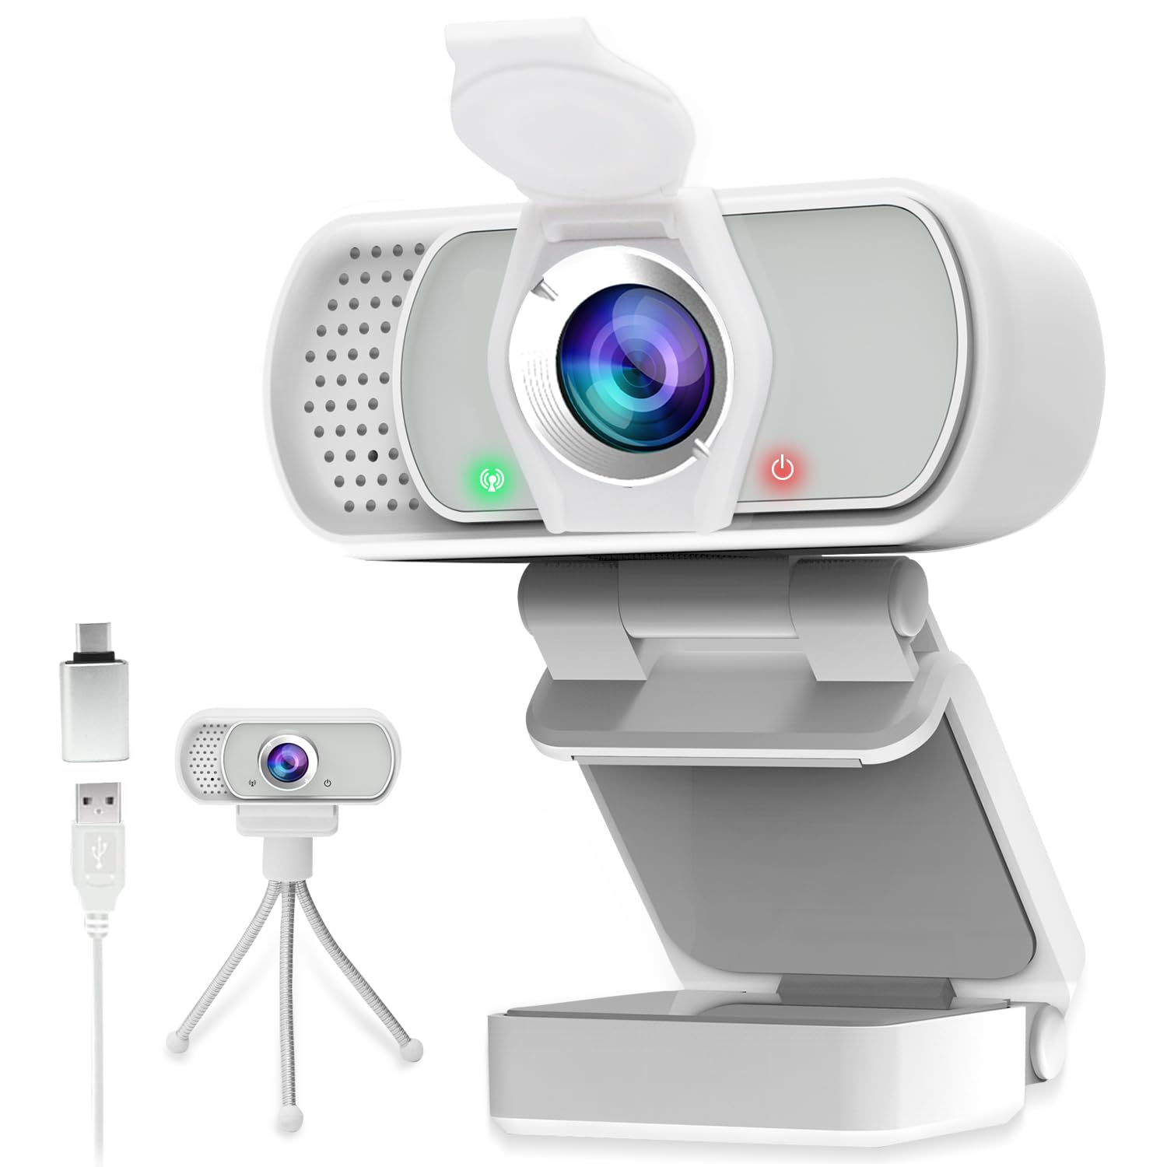





CAPTURING VIDEO FROM WEBCAM
This is the most important part which is used in most projects!
Frame-by-Frame Capture
Continuous video stream processing
Real-Time Processing
Analyze and manipulate video frames instantly
Project Integration
Foundation for computer vision applications
SESSION 1.2

Slide 20




VIDEO CAPTURE CODE
video_capture.py
0
Camera Index
0 = default webcam
Infinite Loop
Continuous frame capture
Press 'Q' to Quit
Exit the video stream
Important
Always release resources!
SESSION 1.2

Slide 21





UNDERSTANDING VIDEO CAPTURE FUNCTIONS
VideoCapture(0)
ord('q')
Opens the default webcam device
Converts character to ASCII code
= default camera index
= 113
cap.read()
cap.release()
Captures a single frame from camera
Releases camera resources
status
→ True if frame captured successfully
⚠️ Always call before exit!
frame
→ 3D NumPy array (image data)
waitKey(1)
destroyAllWindows()
Waits 1ms for key press event
Closes all OpenCV windows
Returns the ASCII code of pressed key
Cleans up display resources
SESSION 1.2

Slide 22

FLIPPING CAMERA
Often webcams are mirrored. Use cv2.flip() to fix the orientation.
0
Vertical Flip
Flips image along horizontal axis (upside down)
flip_camera.py
1
Horizontal Flip
Flips image along vertical axis (mirror effect)
The cv2.flip() function takes two parameters: the image/frame and the flip code.
Both Flip
-1
Flips image both vertically and horizontally
SESSION 1.2

Slide 23







COLOR CONVERSION
OpenCV Default
color_conversion.py
Uses BGR color format by default
ML Models
Many models use RGB format
BGR → RGB
RGB → BGR
MediaPipe Requirement
cv2.COLOR_BGR2RGB
cv2.COLOR_RGB2BGR
Requires RGB input for proper processing
BGR → GRAY
BGR → HSV
cv2.COLOR_BGR2GRAY
cv2.COLOR_BGR2HSV
Solution: Convert between color spaces using cv2.cvtColor()
SESSION 1.2

Slide 24






COLOR CONVERSION METHODS
BGR → Gray
Gray → BGR
cv2.COLOR_BGR2GRAY
cv2.COLOR_GRAY2BGR
BGR → RGB
RGB → BGR
cv2.COLOR_BGR2RGB
cv2.COLOR_RGB2BGR
BGR → HSV
HSV → BGR
cv2.COLOR_BGR2HSV
cv2.COLOR_HSV2BGR
BGR → LAB
BGR → YCrCb
cv2.COLOR_BGR2LAB
cv2.COLOR_BGR2YCrCb
Note: Use cv2.cvtColor(image, conversion_code) to convert between color spaces. Each color space has specific use cases in image processing.
SESSION 1.2

Slide 25







NEGATIVE IMAGE CONVERSION
negative_image.py
Original
Negative
Mathematical Operation
Normal Image
Inverted Image
Subtracts each pixel value from 255
3D Array Processing
Applied to entire BGR pixel array
How it works: For each pixel, the operation calculates: 255 - original_value. This creates the negative effect by inverting brightness levels.
Inverts Colors
Creates opposite color values
SESSION 1.2

Slide 26

DRAWING GRAPHICS ON VIDEO
video_graphics.py
1
Draw Rectangle
Creates UI panel on frame
2
Write Text
Adds status message
3
Display Frame
Shows annotated video
4
Exit on 'Q'
Breaks the loop
Graphics are drawn each frame inside the while loop for real-time overlay.
SESSION 1.2

Slide 27











FRAME PROCESSING CONCEPT
Camera
Frames
Process
Display
Capture Input
Extract Frames
Analyze Frame
Show Result
Camera
OpenCV
Hand Detect
Angle Calc
Servo Map
Arduino
Robot
SESSION 1.2

Slide 28


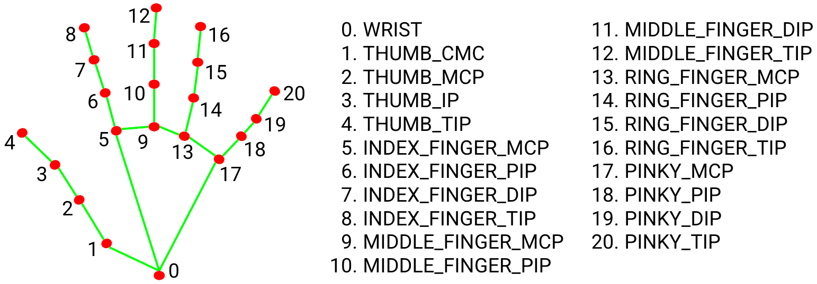



MEDIAPIPE INTEGRATION
MediaPipe detects 21 hand landmarks for precise tracking
Framework developed by Google for building real-time computer vision applications
Key Applications
Hand Tracking
Face Detection
Detect hand landmarks
Recognize facial features
Pose Detection
Gesture Recognition
Track body movements
Identify hand gestures
Works with both images and video streams for real-time processing
21 Landmarks
Real-time
High Accuracy
SESSION 1.2

Slide 29




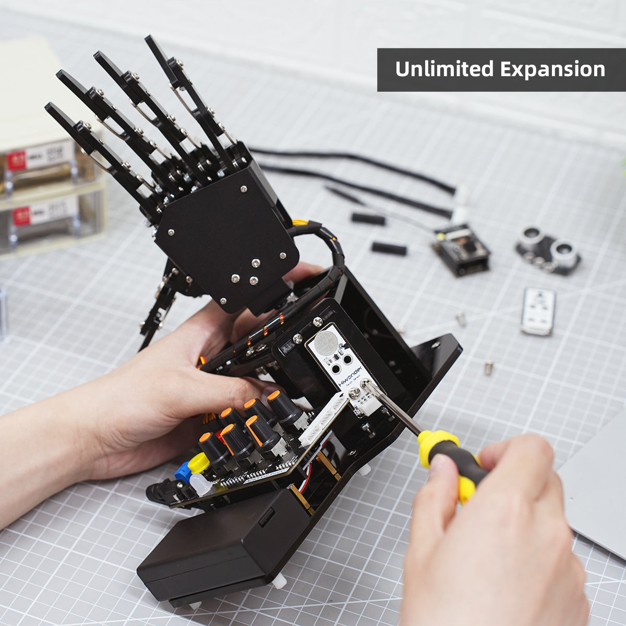







COMPLETE PROJECT FLOW
Camera
OpenCV
End-to-end integration of OpenCV, MediaPipe & Arduino
Video Stream
Frame Capture
Hand Detect
21 Landmarks
Angle Calc
Servo Map
Finger Angles
0-180° Mapping
Arduino
PWM Control
Camera
MediaPipe
Arduino
Technologies Used
Project Outcome
Python + OpenCV
Real-time Hand Tracking
MediaPipe Hand Tracking
Gesture-Controlled Robot
Arduino + Servo Motors
Interactive System
SESSION 1.2

Slide 30






SESSION 1.2
THANK YOU
Questions?
OpenCV
MediaPipe
Arduino
Image Processing
Hand Tracking
Robot Control
By - Ansik Singh Tomar (Aanshik)
Coordinator - Technocrats

